Slide 1

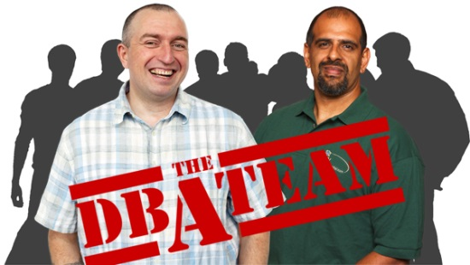
Core Monitoring
Red Gate Software

Slide 2
Demos/Ideas
Capture schema changes. Use DDL trigger to enter an item into a table. Use Monitor to catch additional changes and alert DBAs.
Business Metric – orders taken / hour.

Slide 3
Goals
Understand the value of monitoring
Understand what baselines are
Learn the core items to monitor for SQL Server

Slide 4
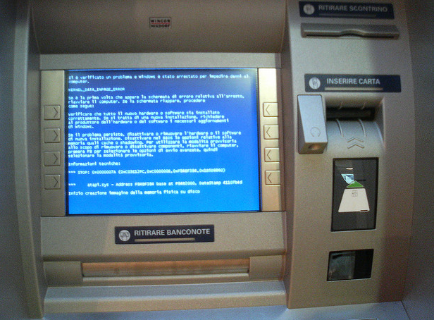
Accidents Happen
Notes:
Accidents happen. Systems will fail. When something happens, you want to know about it as soon as possible.

Slide 5

Workloads Grow
Notes:
Workloads can grow. We’ve seen some famous failures of large systems from Microsoft, Amazon. Facebook, and Twitter. In some cases you can’t do anything, but in many you can see workloads growing and take proactive actions.

Slide 6
What is Monitoring?
Awareness of the state of a system
For SQL Server this includes
  Tracking key hardware metrics (CPU, memory, I/O)
  Tracking database specific metrics (transactions)
Notes:
Monitoring is an awareness of your system. Even if it’s not you, at least some system is tracking how your database is functioning.

Slide 7
Baselines
Using monitoring data over time
Understanding what “normal” is
Trending
Extrapolation
Notes:
Baselines are an extension of monitoring, in what you use the monitoring data over time to gain an understanding of what the normal state of the system is. This can be something you use proactively, or something you check when there is suspicion that a system is not acting normal.
There are two proactive uses for baseline information. The first is trending, and understanding how your system is changing over time (growing or shrinking) along some axis of measurement.
Extrapolation is using the data to predict specific future behaviors, such as the amount of disk space you will need at some point in the future.

Slide 8

What’s Normal?
Is a query that takes 58 minutes to complete, slow?
Notes:
We have no way to know. If this query is supposed to run in 5 minutes, yes. If it normally takes 60 minutes, no.

Slide 9
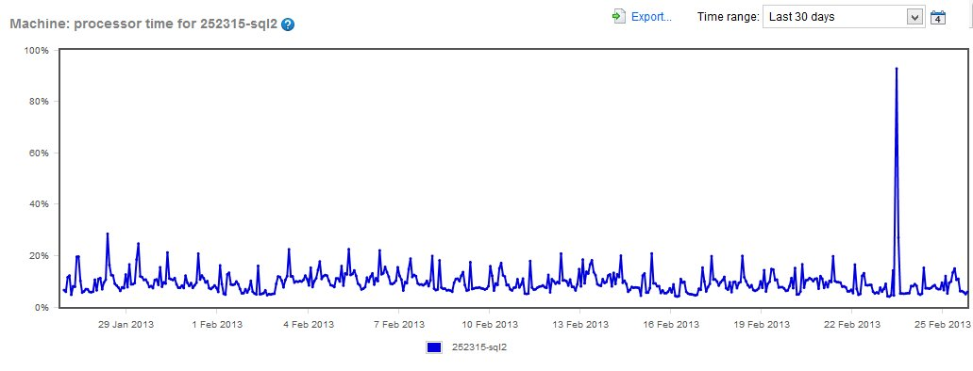
Baselines

Slide 10
Monitoring is not just for performance?
Notes:
Monitoring is for more than just performance. Other things come into play.

Slide 11
Administration and Business
Administrative tasks need to be monitored
  DBCC
  Backups
Business processes should be monitored
  How many orders are you receiving?
  Are ETL loads completing?
Notes:
There is more to monitoring than just performance. Administrative items need to be watched. These do not necessarily impact performance, but they can impact availability and the risk of data loss.
Business items can also let you know that there are potential problems, or even areas of your application that need more attention.

Slide 12
Core Items to Monitor
Lots of choices
  Windows performance counters
  SQL Server performance counters
  Hypervisor counters
  SQL Server management metrics
  Trace/Extended Events
Lots of lists available
  Can be version specific
Notes:
There are lots of choices in terms of which items to monitor on your servers. There are Windows and SQL Server performance based counters. These are items that measure how well the system is performing, like CU%, transactions/sec, and more. There could be hypervisor counters that you need to monitor as well if you are in a virtual environment. If you are unaware of these counters, you might mis-diagnose or mis-understand how your system is performing. There are also SQL Server management counters, things like the time since the last DBCC or backup. Those don’t affect performance, but they are core monitoring items.
Beware that many of the lists available are version specific, and advice may change over time. If you are looking at an article/blog/video/etc, please ensure that it corresponds to your version. New information and features sometimes change the monitoring you need to set up.

Slide 13
Core Items to Monitor
Performance Counters
  Memory – Available MBytes
  Paging File – % Usage
  Physical Disk – Avg. Disk sec/Read
  Physical Disk – Avg. Disk sec/Write
  Physical Disk – Disk Reads/sec
  Physical Disk – Disk Writes/sec
  Processor – % Processor Time
  SQLServer: Buffer Manager – Page life expectancy
  SQLServer: General Statistics – User Connections
  SQLServer: Memory Manager – Memory Grants Pending
  SQLServer: SQL Statistics – Batch Requests/sec
  SQLServer: SQL Statistics – Compilations/sec
  SQLServer: SQL Statistics – Recompilations/sec
  System – Processor Queue Length
  From: SQL Server Perfmon (Performance Monitor) Best Practices

Slide 14
Core Items to Monitor
Administrative Items
  Machine is running (Windows and SQL Server levels)
  Backup overdue (full or log)
  DBCC CHECKDB overdue
  Cluster/AG failover
  Deadlock occurred
  Indexes Fragmented
  Job Failure/Duration
  Error Log Entries (sev 18 and above errors)
Notes:
Here are counters that help ensure you are checking things that impact availability and reliability.

Slide 15
Core Items to Monitor
Hypervisor Counters
  CPU usage
  Memory usage (especially balloon counters and swapping)
  Disk I/O
  Check with your hypervisor vendor/consultants
Notes:
Here are counters that help ensure you are checking things that impact availability and reliability.

Slide 16
Core Items to Monitor
Demo
  Basic counters for performance monitoring
  Querying counters inside of SQL Server
  SQL Trace
  SQL Monitor makes everything easy

Slide 17
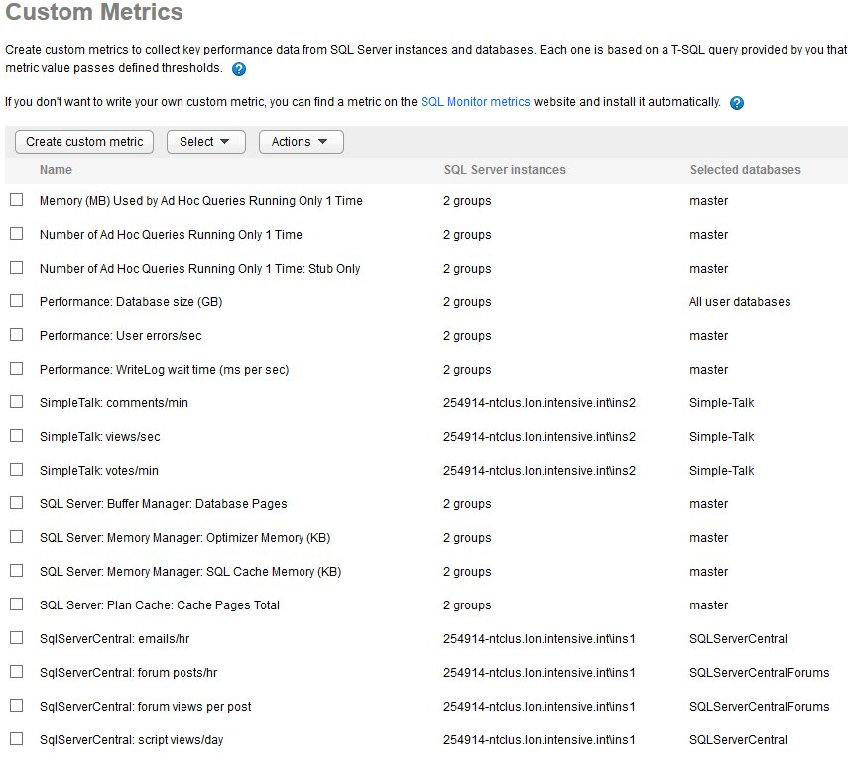
http://monitor.red-gate.com

Slide 18
Homework
Make sure you have a baseline of all instances
Set a reminder to periodically review “normal”

Slide 19
Goals
Understand the value of monitoring
Understand what baselines are
Learn the core items to monitor for SQL Server

Slide 20

The End
Questions?
www.sqlservercentral.com/forums
Sponsored by Red Gate Software and the SQL DBA Bundle
Speak to the Red Gate team during the breaks for more info about the tools in the SQL DBA Bundle
Backup and recovery
Troubleshooting
Productivity
Performance monitoring
Change management
Storage and capacity planning
Documentation

Slide 21

Learn More
http://www.sqlservercentral.com
http://www.simple-talk.com
http://www.red-gate.com/products/dba/dba-bundle/entrypage/hard-earned-lessons
http://www.scarydba.com/tag/query-tuning/
http://voiceofthedba.wordpress.com/tag/administration/

Slide 22
References
Monitoring (Wikipedia) - http://en.wikipedia.org/wiki/Monitoring
Monitoring SQL Server - http://msdn.microsoft.com/en-us/library/ee377023(v=bts.10).aspx
Performance Monitoring and Tuning Tools - http://msdn.microsoft.com/en-us/library/ms179428.aspx
SQL Monitor from Red Gate - http://www.red-gate.com/products/dba/sql-monitor/
Trending - http://www.thefreedictionary.com/trending
Extrapolation - http://en.wikipedia.org/wiki/Extrapolation
Top 10 SQL Server Counters for Monitoring SQL Server Performance - http://www.databasejournal.com/features/mssql/article.php/3932406/Top-10-SQL-Server-Counters-for-Monitoring-SQL-Server-Performance.htm
Correlating SQL Server Profiler with Performance Monitor - https://www.simple-talk.com/sql/database-administration/correlating-sql-server-profiler-with-performance-monitor/
SQL Server Perfmon (Performance Monitor) Best Practices - http://www.brentozar.com/archive/2006/12/dba-101-using-perfmon-for-sql-performance-tuning/
Correlate a Trace with Windows Performance Log Data - http://technet.microsoft.com/en-us/library/ms191152.aspx

Slide 23
Images
Blue screen of death - http://www.flickr.com/photos/_aldem/3196618156/
Twitter overload - http://www.flickr.com/photos/renaissancechambara/2584497396/
Abnormal load - http://www.flickr.com/photos/nickwebb/6189613363/
Statistics for the Utterly Confused - http://www.amazon.com/Statistics-Utterly-Confused-Series-ebook/dp/B000JMKOWI/ref=sr_1_2?ie=UTF8&qid=1360886590&sr=8-2&keywords=statistics+for+the+utterly+confused

